Slide 1
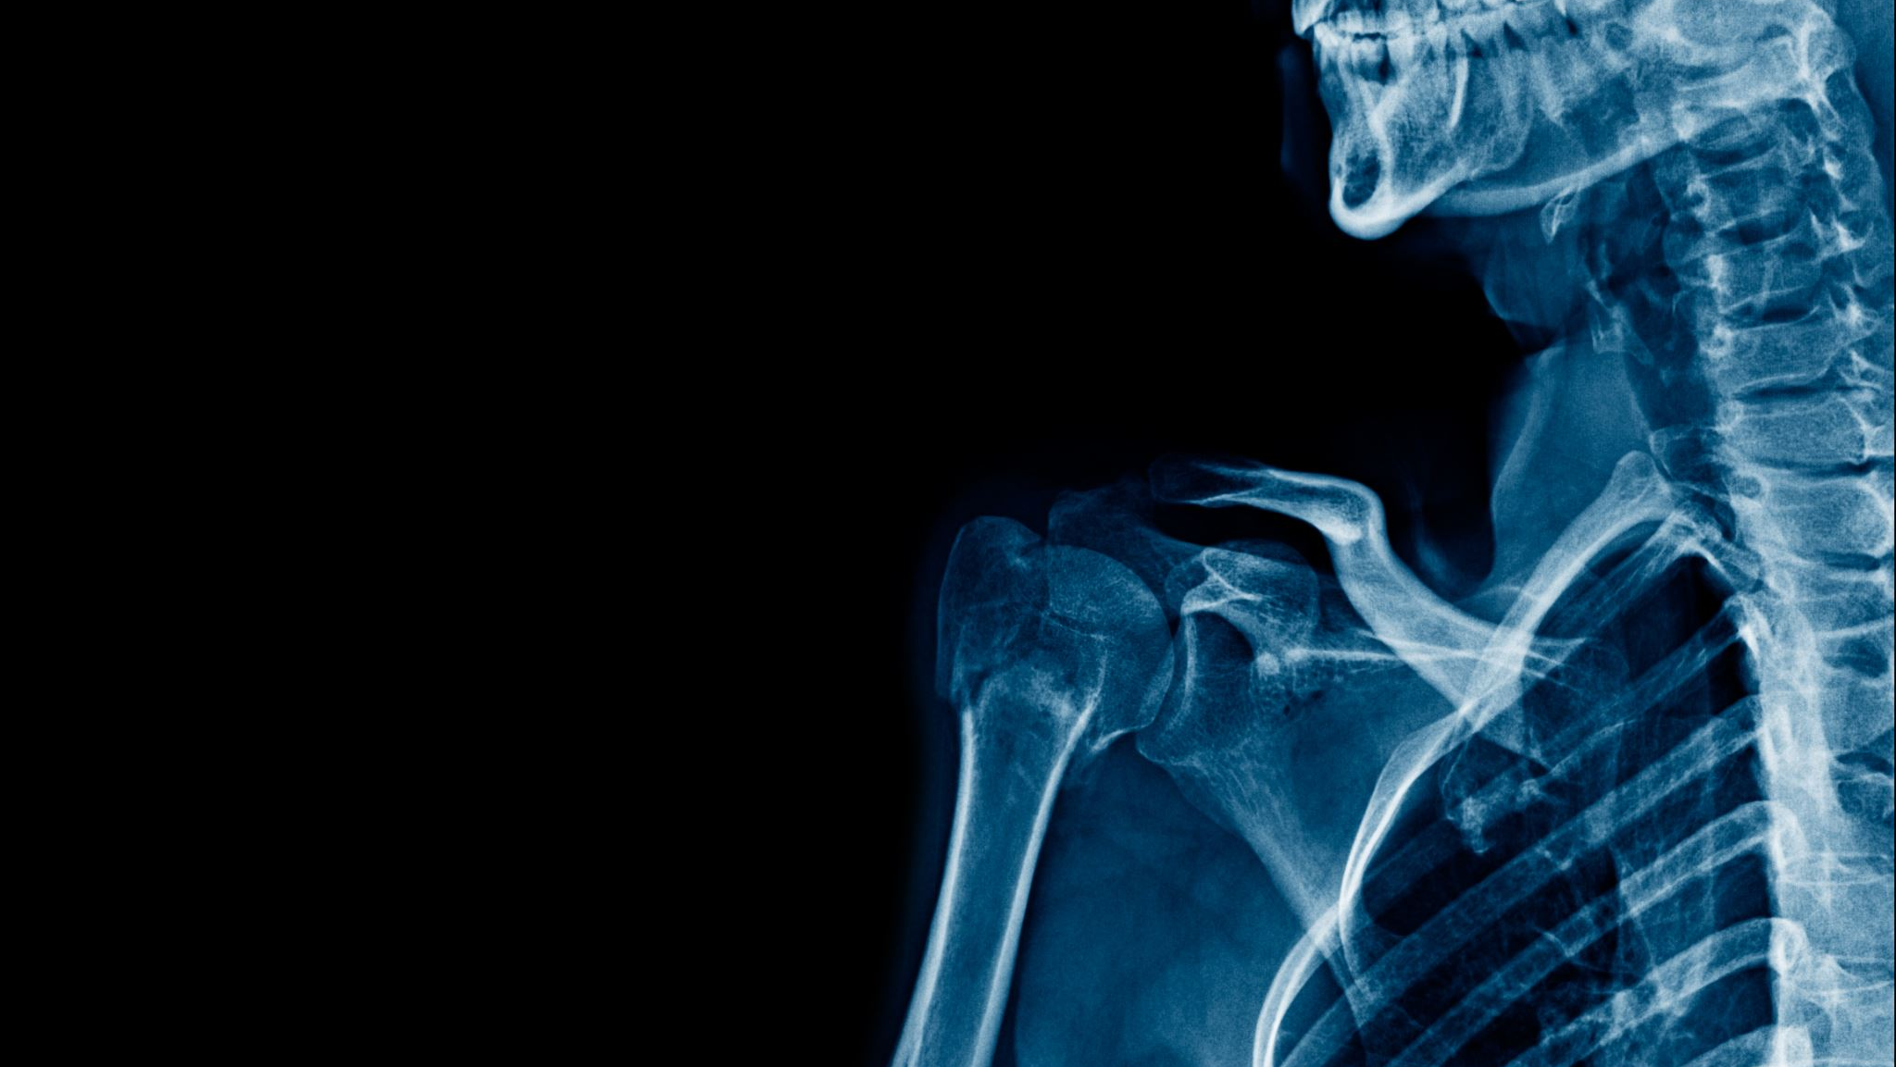
COVID-19 Classification from Chest X-Ray images using CNN
SHAI Level 2 Training 2024
Yasmin Hamad
Sawsan Yusuf

Slide 2
Introduction
In this project, we aimed to develop a Convolutional Neural Network (CNN) algorithm for the accurate detection of COVID-19 from Chest X-ray (CXR) images.
The challenge was to develop an algorithm that could accurately detect COVID-19, as well as distinguish between viral pneumonia, and normal cases based on an input chest X-ray image.

Slide 3
1. Dataset Description
In this project, we used the COVID CXR Image Dataset which consists of a total of 1196 posteroanterior (PA) views of chest X-ray images comprising Normal, Viral, and
COVID-19 affected patients.
The distribution of images in COVID-19, Viral, and Normal patients are shown in Table 1.
Image Class | # Images
COVID-19 | 295
Viral Pneumonia | 433
Normal | 468
Table 1: Distribution of images in the dataset

Slide 4
2. Exploratory Data Analysis
Next, we plotted sample images of each class to understand the visual difference among different classes of images.

Slide 5
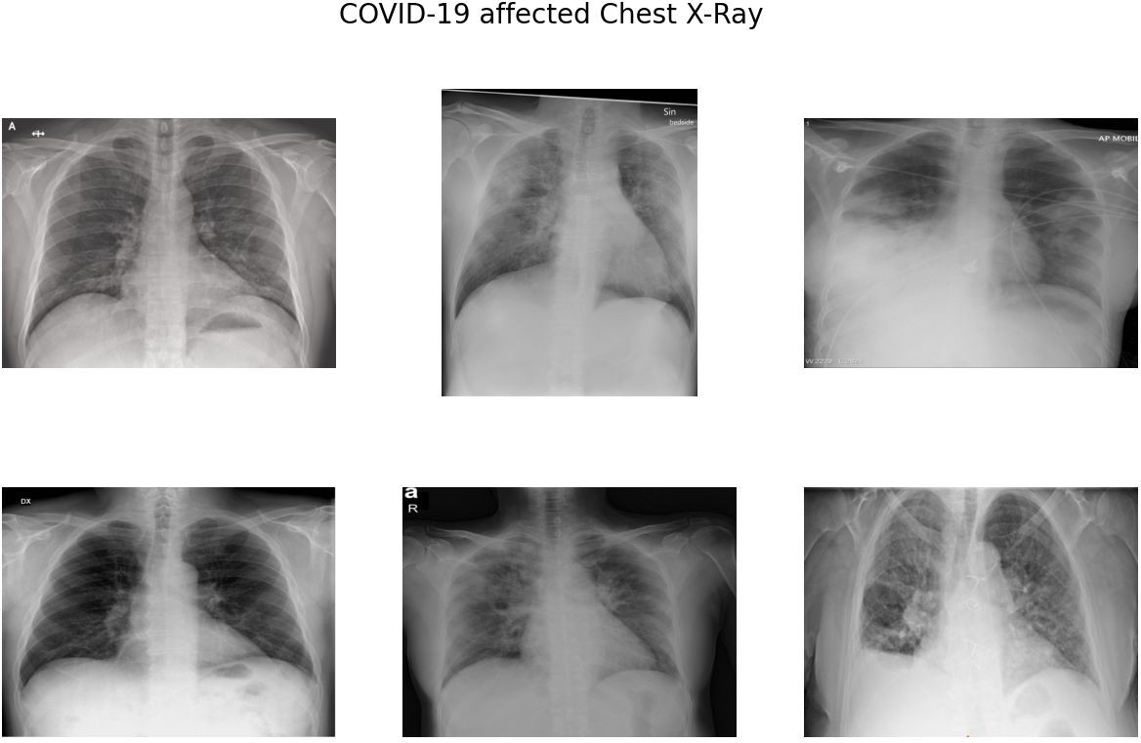

Slide 6
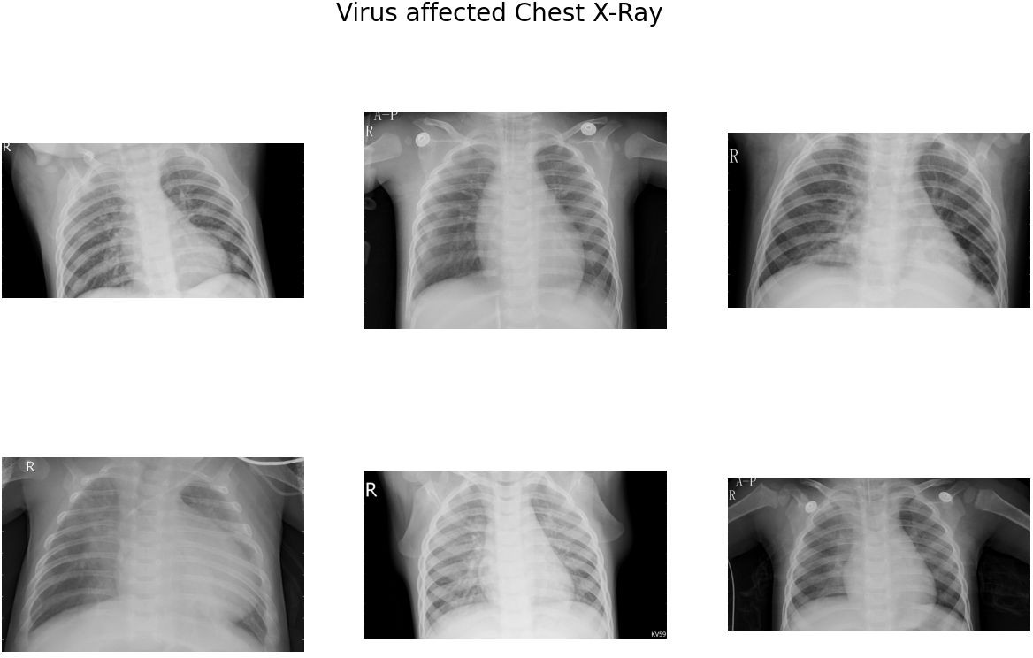

Slide 7
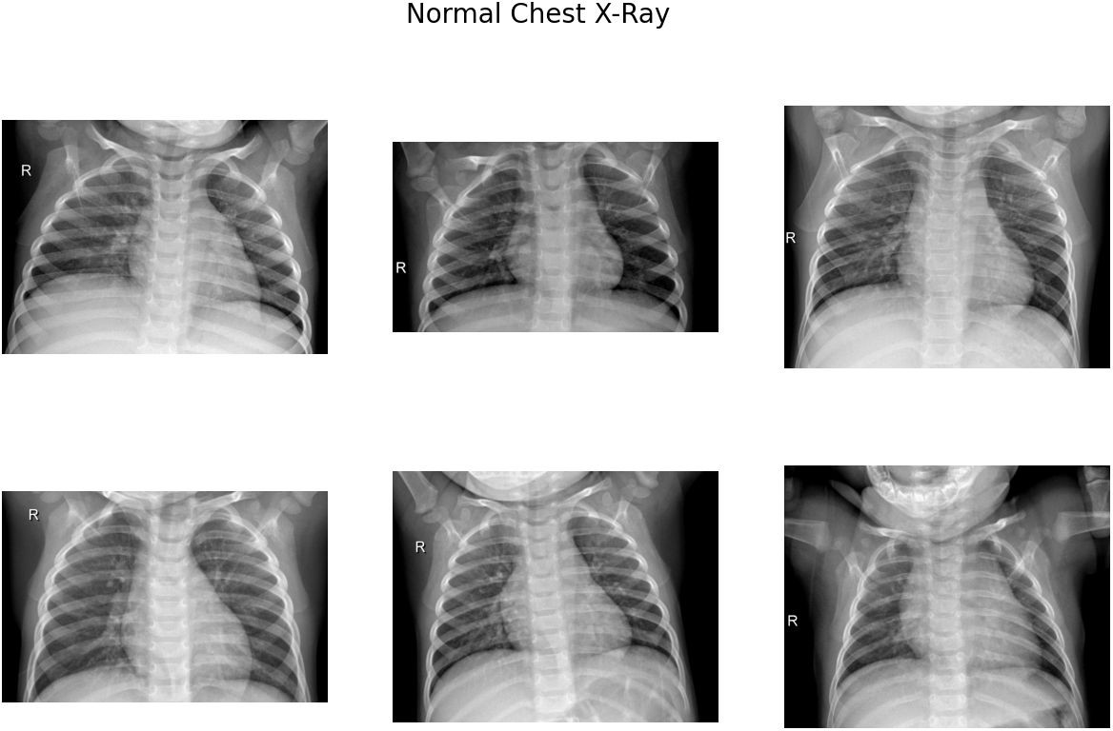

Slide 8

The sample images of COVID-19 CXR leave no doubt that normal CXR images depict clear lungs without any abnormal opacification patterns. It is important to note that viral pneumonia (middle) presents a more diffuse "interstitial" pattern in both the left and right lungs, while COVID-19 CXR images clearly show ground-glass opacification and consolidation in the right upper lobe and left lower lobe.

Slide 9
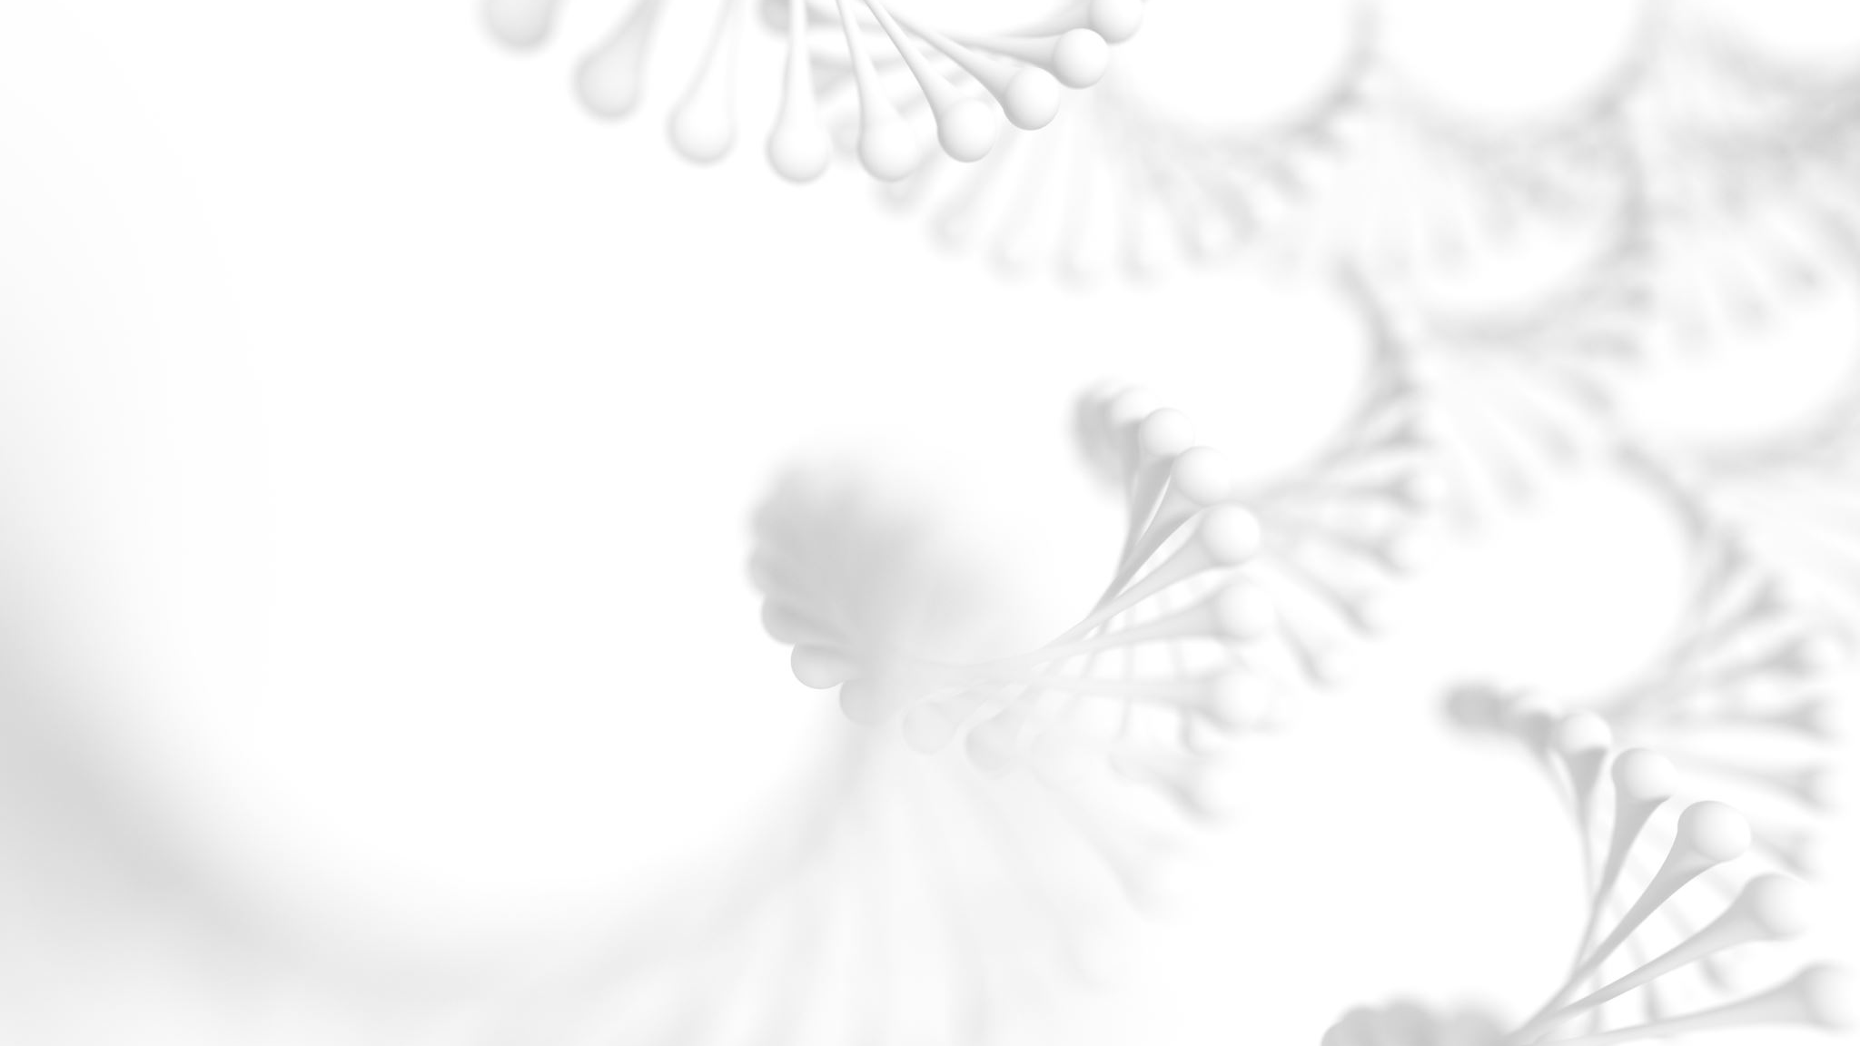
Data Loading & Image pre-processing
In this step, we loaded the data and performed pre-processing of chest x-ray images so that model can understand the pattern hidden in the image for a particular class.
After loading the images, we performed a white balance operation to ensure color accuracy, followed by resizing the images to a uniform size of 224x224 pixels. We then assigned label values of 0, 1, and 2 to the classes Normal, COVID-19, and Virus Infection, respectively.

Slide 10

Next, we converted the images into NumPy arrays for easier processing and randomized the order so that they were not sorted according to any specific pattern during the training of our CNN model. This helps to prevent any bias towards a particular order and improves the overall performance of the model.

Slide 11
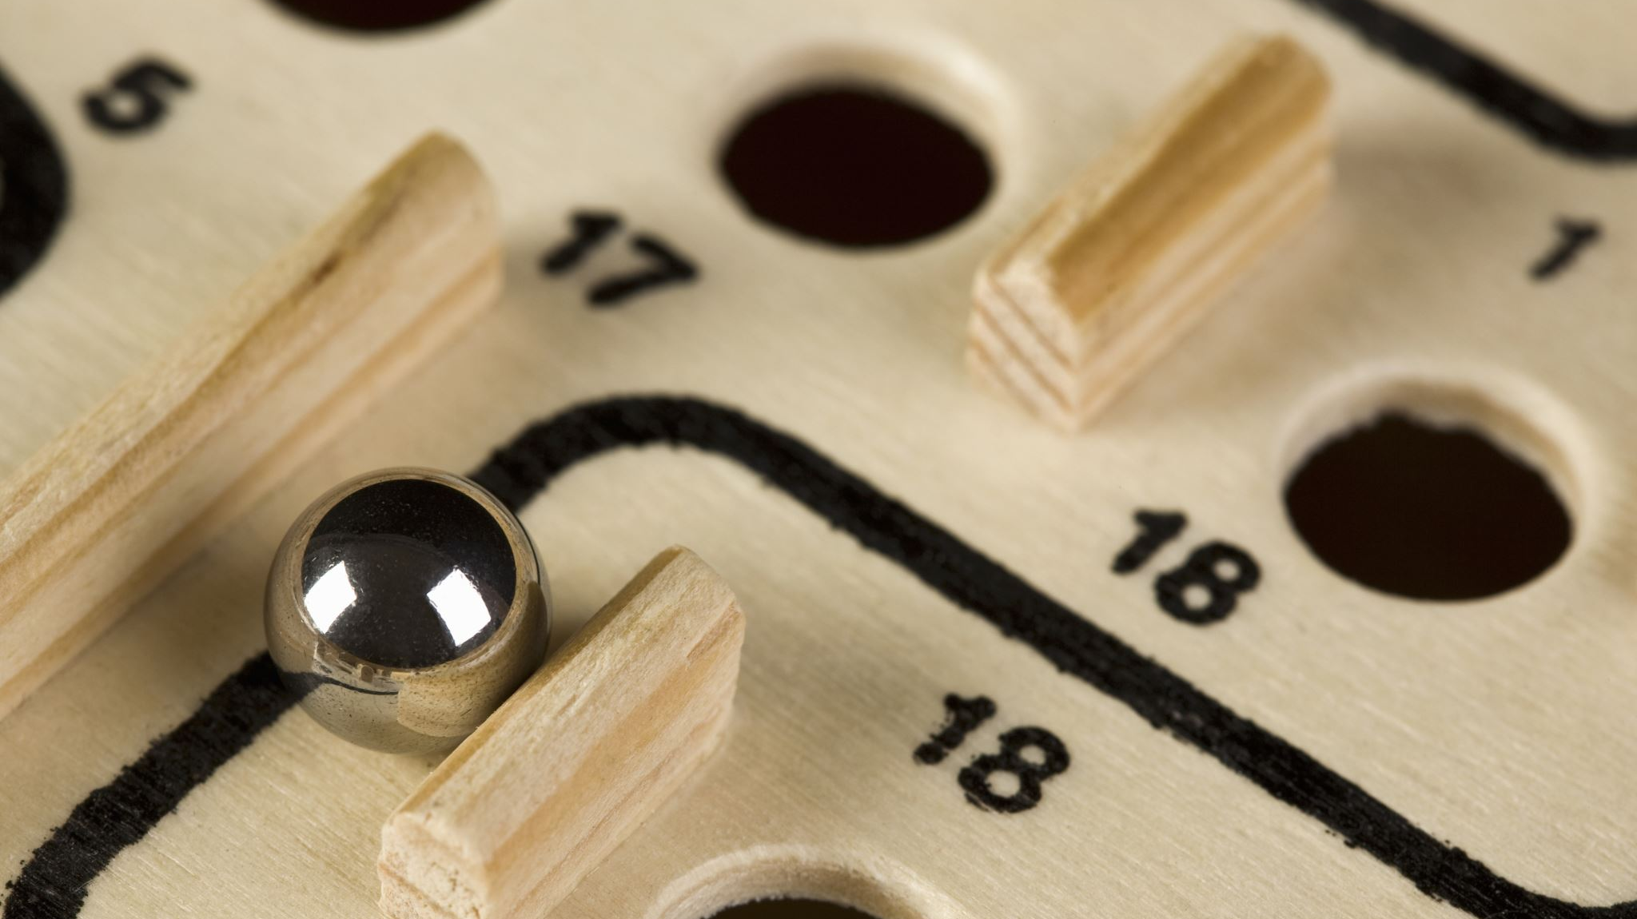
Train Test Split
In this step, we split our data into training and test sets with an 80:20 ratio. We used 80% of the data for training and the remaining 20% for evaluating the model.
5. Image Normalization
In this step, we normalized the given data by dividing it by 255. This was done to ensure that the data falls within the range of 0 to 1. Moving on, we need to perform target encoding for which we'll be utilizing the to_categorical method that's available in keras.utils. Since we have three classes, we'll be passing 3 as a parameter in this method.

Slide 12

Image Augmentation
In this stage, we have implemented image augmentation to enhance the training data and build a more reliable model. Image augmentation is a technique in which we apply various transformations to the training images, resulting in the introduction of some noise that helps in creating a robust model. For this project, we have utilized three transformations, namely rotation range, horizontal flip and fill mode.

Slide 13
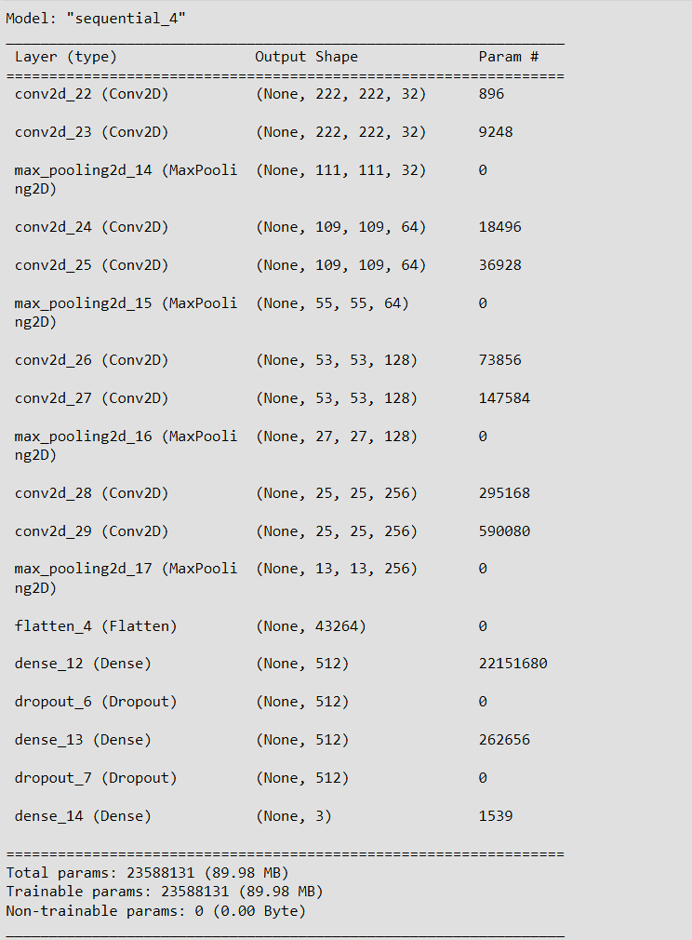
7. Model Building

Slide 14
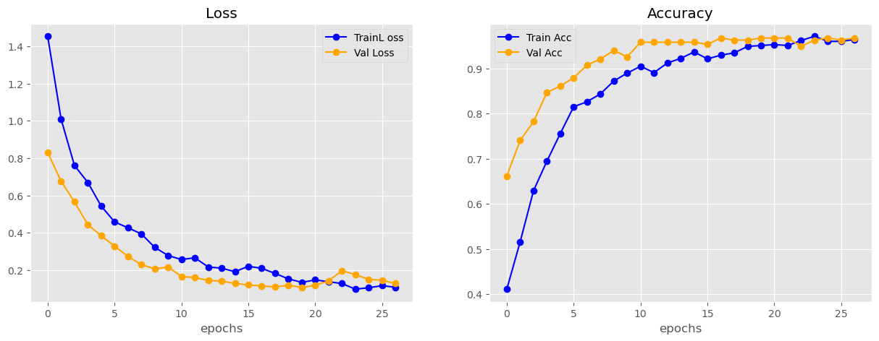
8.1 Model Evaluation

Slide 15
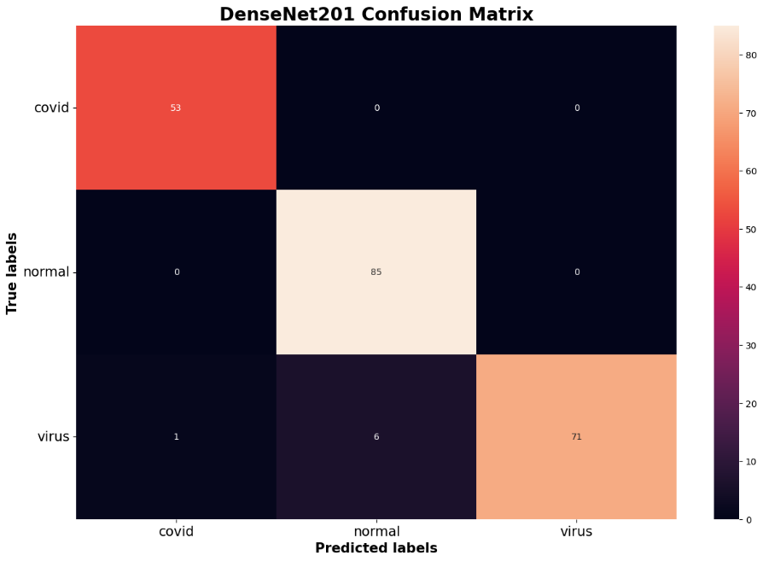
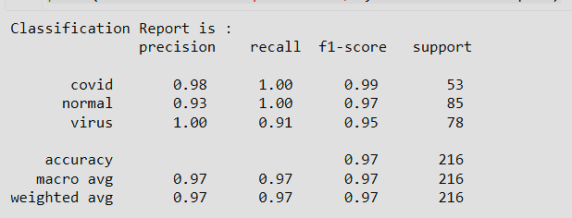
8.2 Model Evaluation

Slide 16
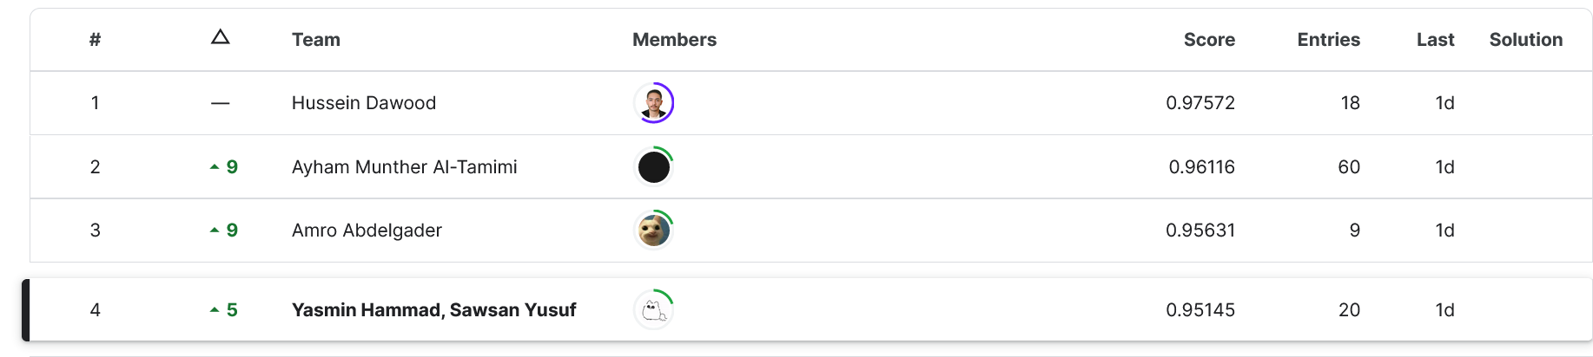
Kaggle private score
Making submission

Slide 17

The end thank you

